Slide 2
Learning Objectives
LO 2.1 Summarize the view that most geologists held prior to the 1960s regarding the geographic positions of the ocean basins and continents.
LO 2.2 List and explain the evidence Wegener presented to support his continental drift hypothesis.
LO 2.3 List the major differences between Earth’s lithosphere and asthenosphere and explain the importance of each in the plate tectonics theory.
LO 2.4 Sketch and describe the movement along a divergent plate boundary that results in the formation of new oceanic lithosphere.
LO 2.5 Compare and contrast the three types of convergent plate boundaries and name a location where each type can be found.

Slide 3
Learning Objectives (cont.)
LO 2.6 Describe the relative motion along a transform fault boundary and locate several examples of transform faults on a plate boundary map.
LO 2.7 Explain why plates such as the African and Antarctic plates are increasing in size, while the Pacific plate is decreasing in size.
LO 2.8 List and explain the evidence used to support the plate tectonics theory.
LO 2.9 Describe two methods researchers use to measure relative plate motions.
LO 2.10 Describe plate–mantle convection and explain two of the primary driving forces of plate motion.

Slide 4
2.1 From Continental Drift to Plate Tectonics
Geologists through the ocean basins and continents had fixed positions and were very old.
A scientific revolution unfolded.

Slide 5
2.2 Continental Drift: An Idea Before Its Time
Alfred Wegener
First proposed hypothesis, 1915
Published The Origin of Continents and Oceans
Continental drift hypothesis
Supercontinent called Pangaea began breaking apart about 200 million years ago.
Continents “drifted” to present positions.
Continents “broke” through the ocean crust.

Slide 6
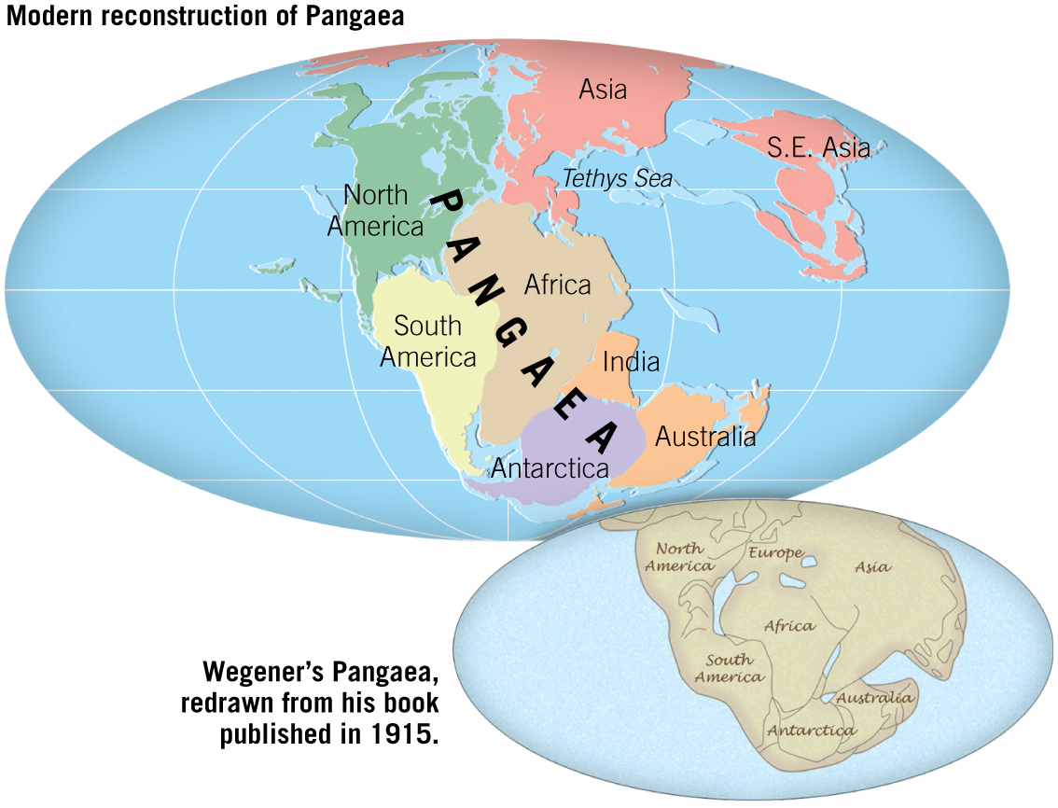
Pangaea Approximately 200 Million Years Ago
Tutorial

Slide 7
2.2 Continental Drift: An Idea Before Its Time
Wegener’s continental drift hypothesis
Evidence used by Wegener
Fit of South America and Africa
Fossils match across the seas
Rock types and structures match
Ancient climates
Main objection to Wegener’s proposal was its inability to provide a mechanism.

Slide 8
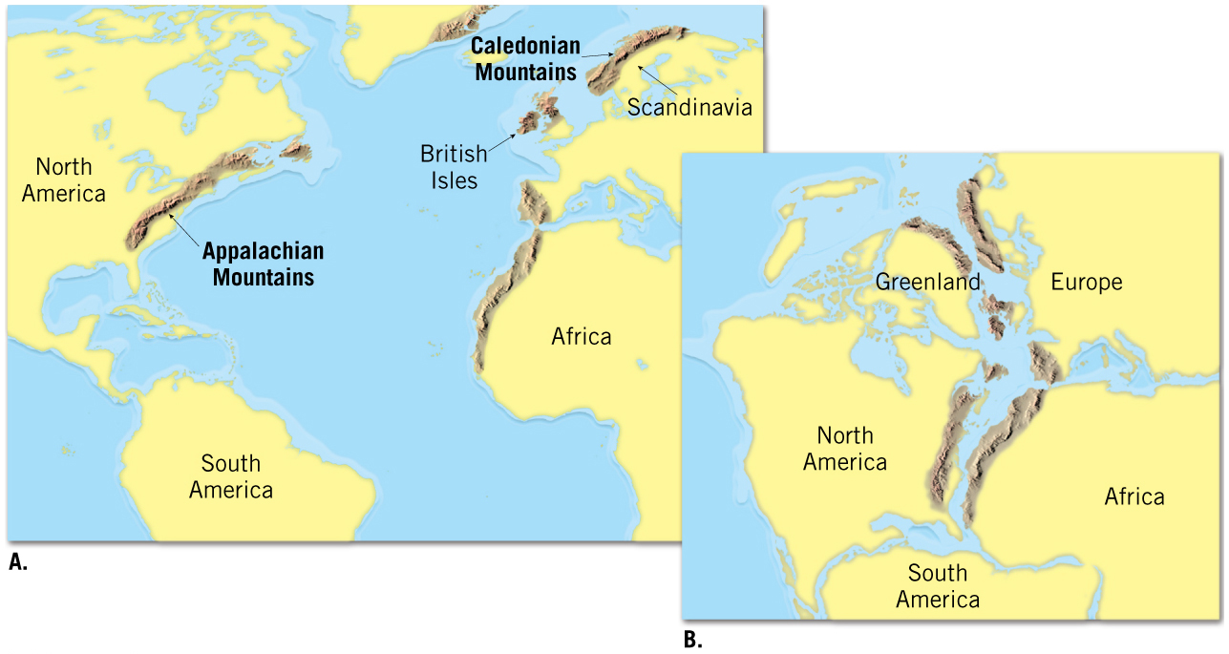
Wegener’s Matching of Mountain Ranges on Different Continents

Slide 9
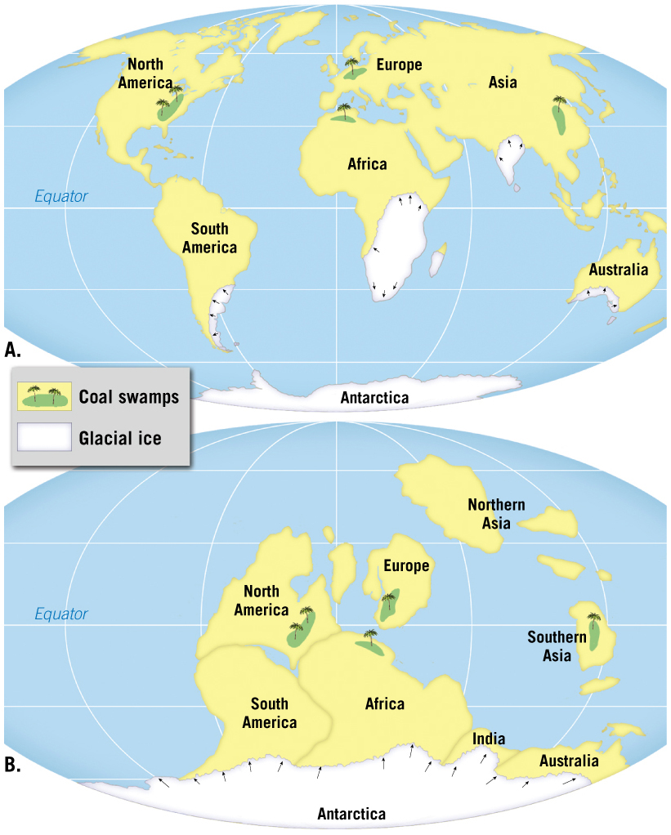
Paleoclimatic Evidence for Continental Drift

Slide 10
2.2 Continental Drift: An Idea Before Its Time
Objections to the continental drift hypothesis
Wegener incorrectly suggested that the gravitational forces of the Moon and Sun were capable of moving the continents.
Wegener also incorrectly suggested that continents broke through the ocean crust.
There was strong opposition to this hypothesis from all areas of the scientific community.

Slide 11
2.3 The Theory of Plate Tectonics
More encompassing than continental drift
Associated with Earth’s rigid outer shell
Called the lithosphere
Consists of several plates
Plates are moving slowly
Largest plate is the Pacific plate
Plates are mostly beneath the ocean

Slide 12
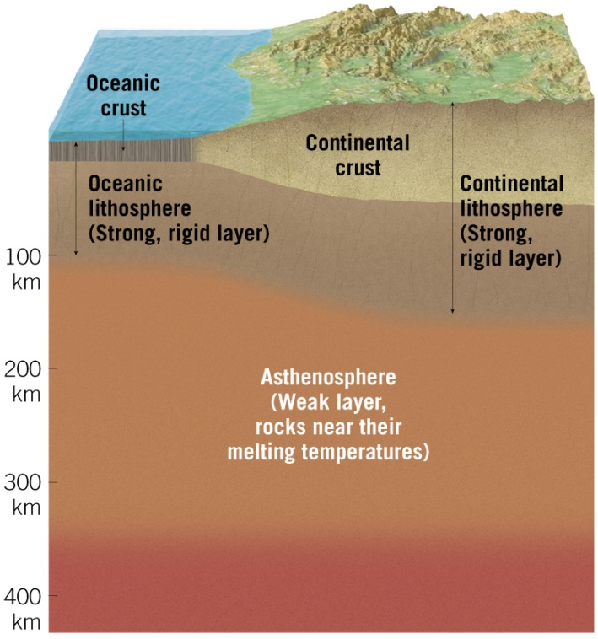
2.3 The Theory of Plate Tectonics (cont.)
Tutorial
Asthenosphere
Exists beneath the lithosphere
Hotter and weaker than lithosphere
Allows for motion of lithosphere

Slide 13
2.3 The Theory of Plate Tectonics (cont.)
Plate boundaries
All major interactions among plates occur along their boundaries.
Types of plate boundaries
Divergent plate boundaries (constructive margins)
Continental rifts form at spreading centers within a continent.
Convergent plate boundaries (destructive margins)
Plates collide, an ocean trench forms, and lithosphere is subducted into the mantle.
Transform plate boundaries
Plates slide past one another and no lithosphere is created or destroyed.

Slide 14
2.4 Divergent Plate Boundaries and Seafloor Spreading
Divergent plate boundaries (constructive margins)
Two plates move apart.
Mantle material upwells to create new seafloor.
Ocean ridges and seafloor spreading
Oceanic ridges develop along well-developed boundaries.
Along ridges, seafloor spreading creates new seafloor.
Can also occur in continental crust

Slide 15
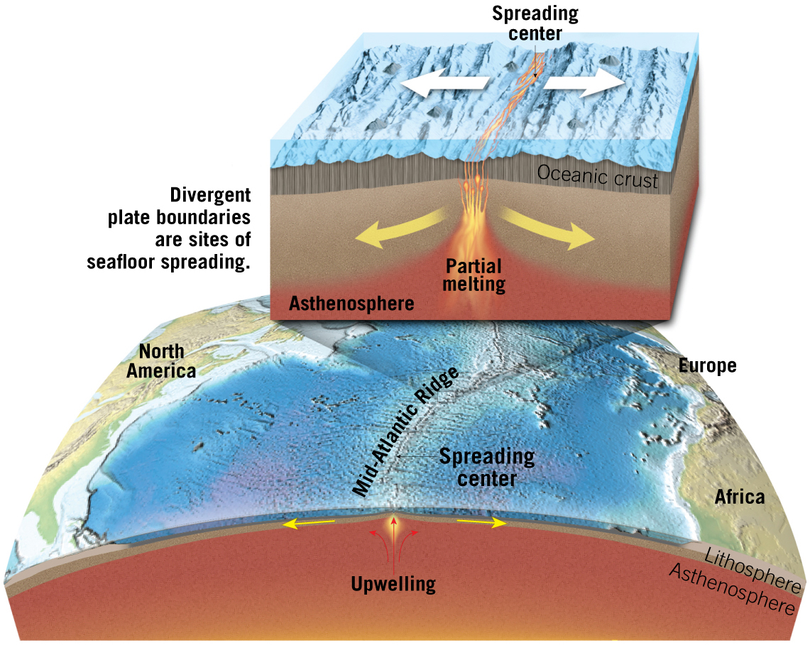
2.4 Divergent Plate Boundaries and Seafloor Spreading (cont.)

Slide 16
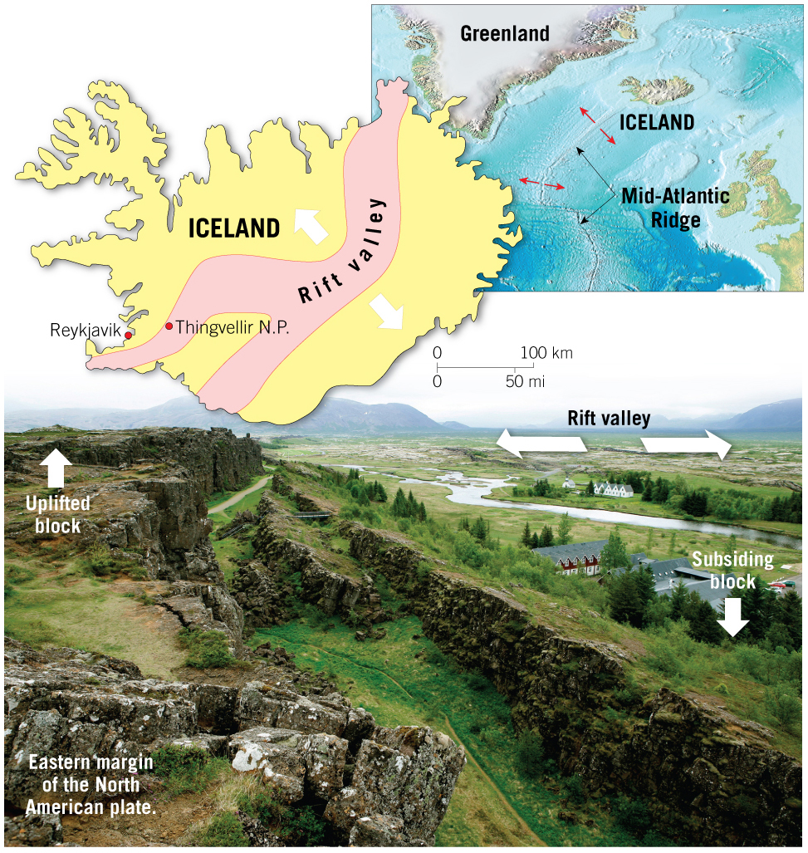
Rift Valley in Iceland
Mobile Field Trip

Slide 17
2.5 Convergent Plate Boundaries and Subduction
Convergent plate boundaries (destructive margins)
Oceanic–continental convergence
Denser oceanic slab sinks into the asthenosphere.
Pockets of magma develop and rise.
Continental volcanic arcs form.
Examples include the Andes, Cascades, and the Sierra Nevadan system.

Slide 18
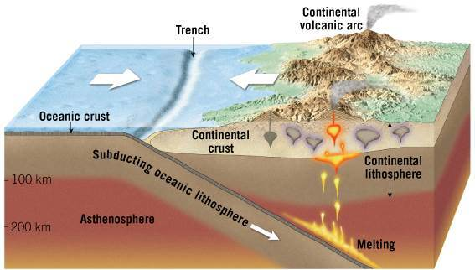
An Oceanic–Continental Convergent Plate Boundary
Tutorial

Slide 19
2.5 Convergent Plate Boundaries and Subduction
Convergent plate boundaries (destructive margins)
Oceanic–oceanic convergence
Two oceanic slabs converge and one descends beneath the other.
Often forms volcanoes on the ocean floor.
Volcanic island arcs form as volcanoes emerge from the sea.
Examples include the Aleutian, Mariana, and Tonga islands.

Slide 20
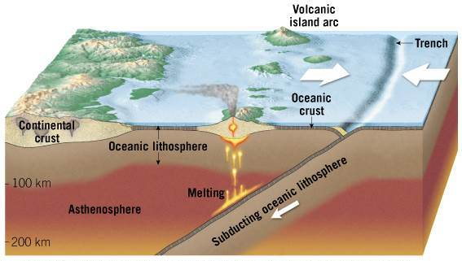
An Oceanic–Oceanic Convergent Plate Boundary

Slide 21
2.5 Convergent Plate Boundaries and Subduction
Convergent plate boundaries (destructive margins)
Continental–continental convergence
When subducting plates contain continental material, two continents collide.
Can produce new mountain ranges such as the Himalayas.

Slide 22
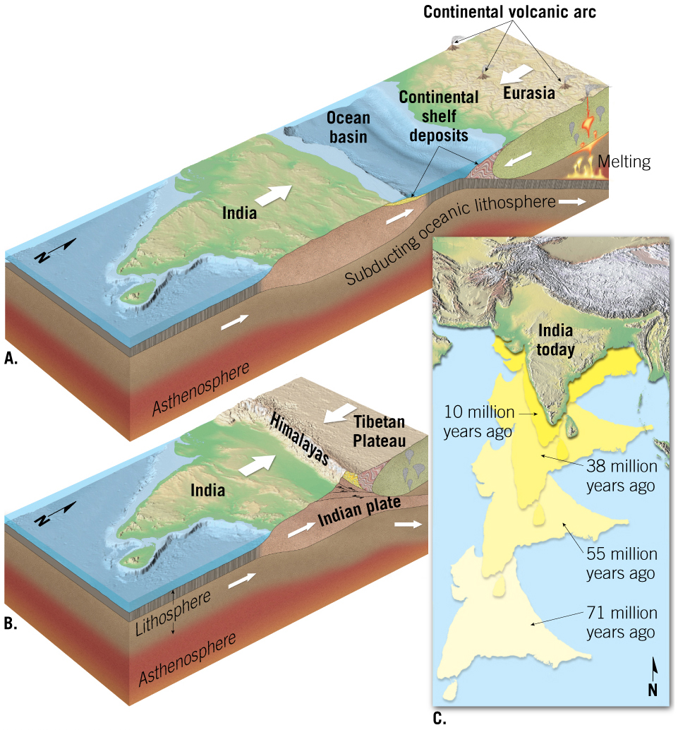
The Collision of India and Asia Produced the Himalayas (Before)
Animation

Slide 23
2.6 Transform Plate Boundaries
Transform Plate Boundaries
Plates slide past one another and no lithosphere is created or destroyed.
Most join two segments of an oceanic ridge system along breaks in the oceanic crust known as fracture zones.
Transform faults can also move ridge crests toward subduction zones.
A few transform faults cut through continental crust.
Examples include:
The San Andreas Fault
The Alpine Fault of New Zealand

Slide 24
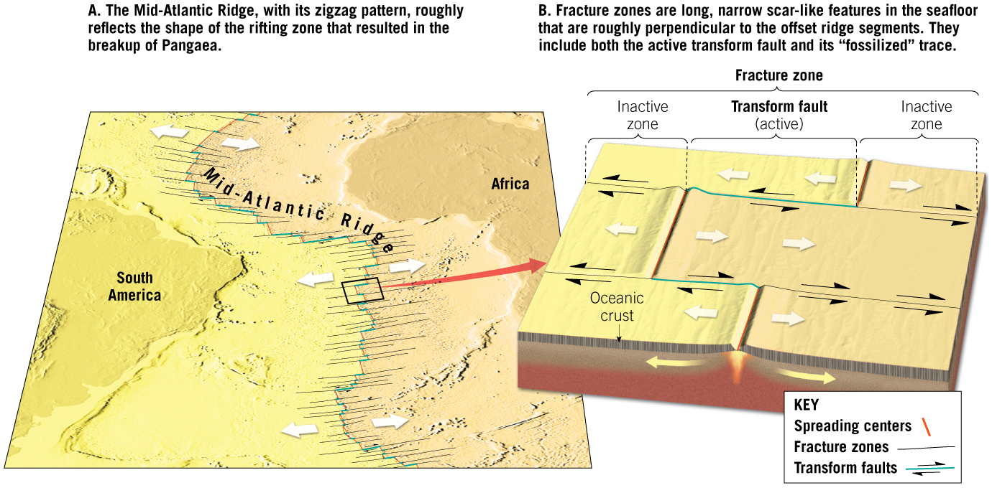
2.6 Transform Plate Boundaries (cont.)
Tutorial

Slide 25
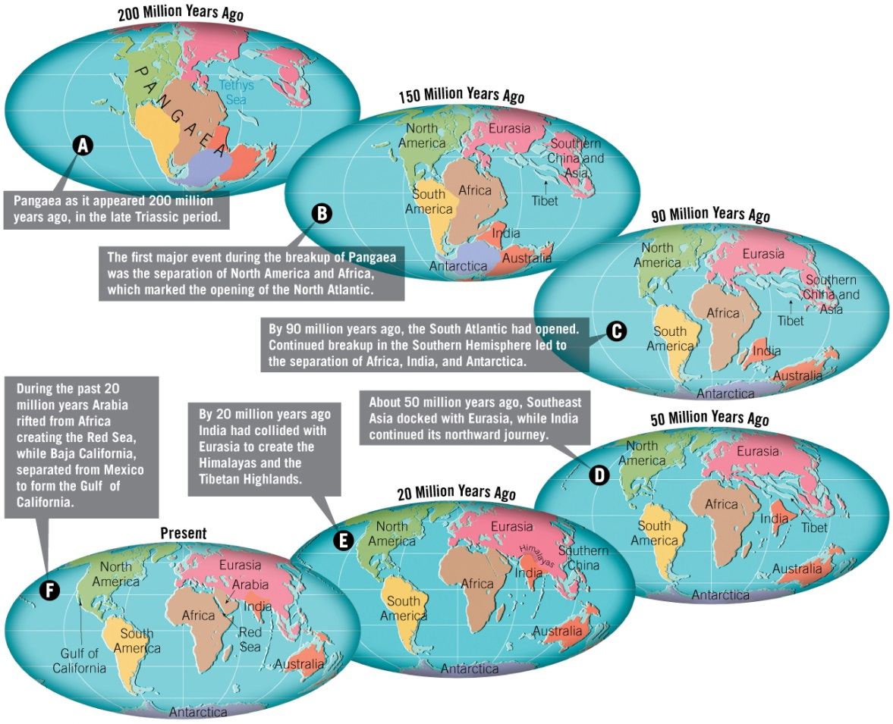
2.7 How Do Plates and Plate Boundaries Change?
Earth’s total surface area does not change
Pangaea existed 200 million years ago

Slide 26
2.7 How Do Plates and Plate Boundaries Change? (cont.)
Present-day motions have been extrapolated into the future some 50 million years
Areas west of the San Andreas Fault slide northward past the North American plate.
Africa collides with Eurasia, closing the Mediterranean and initiating mountain-building.
Australia and new Guinea are on a collision course with Asia.

Slide 27
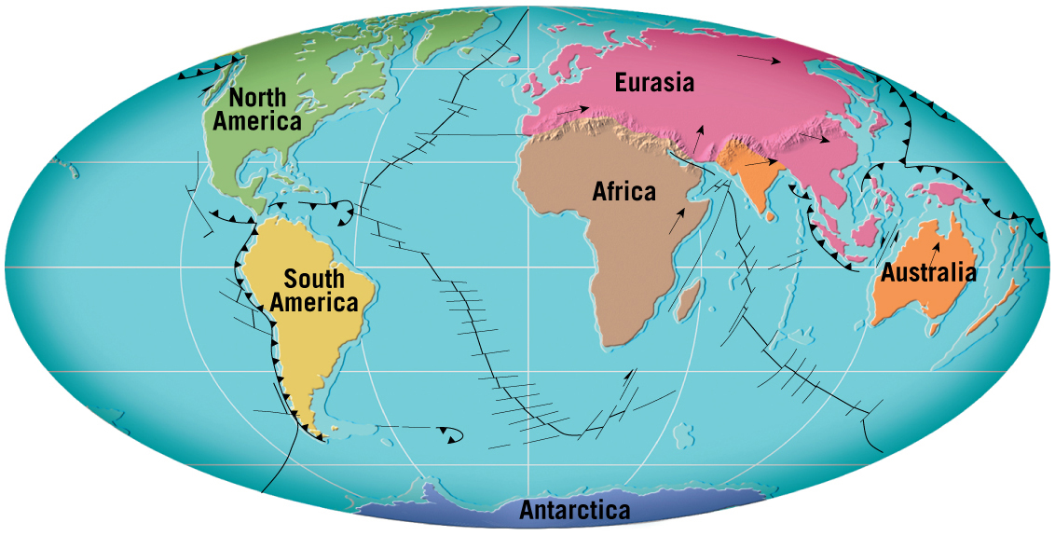
A Possible View of the World 50 Million Years from Now

Slide 28
2.8 Testing the Plate Tectonics Model
Evidence from ocean drilling
Some of the most convincing evidence confirming seafloor spreading has come from drilling directly into ocean-floor sediment.
Age of deepest sediments
Thickness of ocean-floor sediments verifies seafloor spreading.

Slide 29
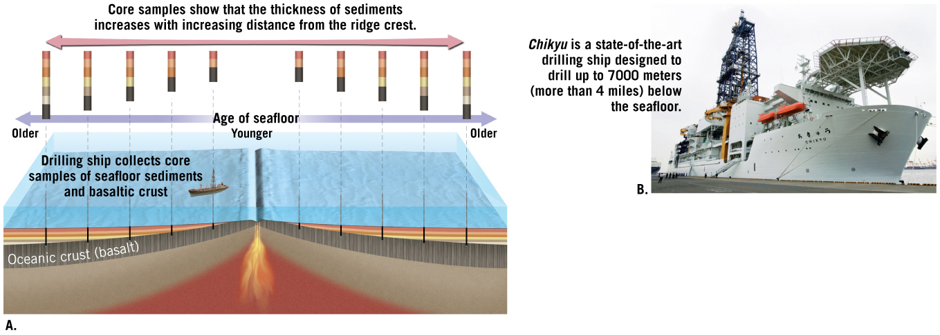
Evidence from Ocean Drilling

Slide 30
2.8 Testing the Plate Tectonics Model
Hot spots and mantle plumes
Caused by rising plumes of mantle material.
Volcanoes can form over them (Hawaiian island chain).
Mantle plumes
Long-lived structures
Some originate at great depth, perhaps at the mantle-core boundary.

Slide 31
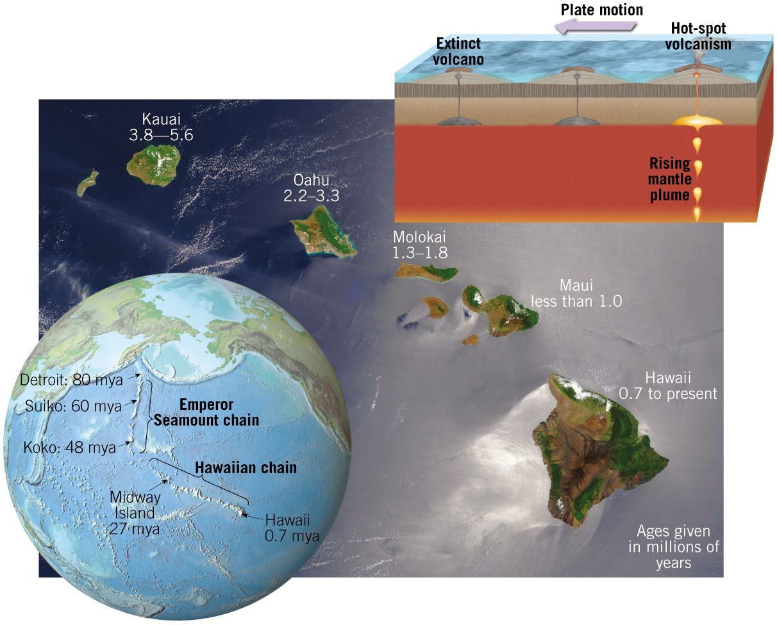
Hot Spots and Hot-Spot Tracks

Slide 32
2.8 Testing the Plate Tectonics Model
Evidence for the plate tectonics model
Paleomagnetism
Probably the most persuasive evidence
Ancient magnetism preserved in rocks
Paleomagnetic records show
Polar wandering (evidence that continents moved)
Earth’s magnetic field reversals
Recorded in rocks as they form at oceanic ridges

Slide 33
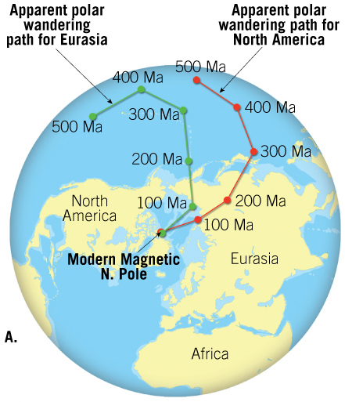
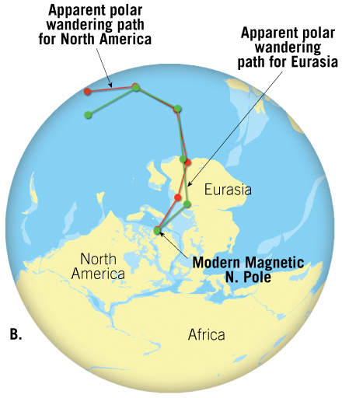
Apparent Polar-Wandering Paths for Eurasia and North America

Slide 34
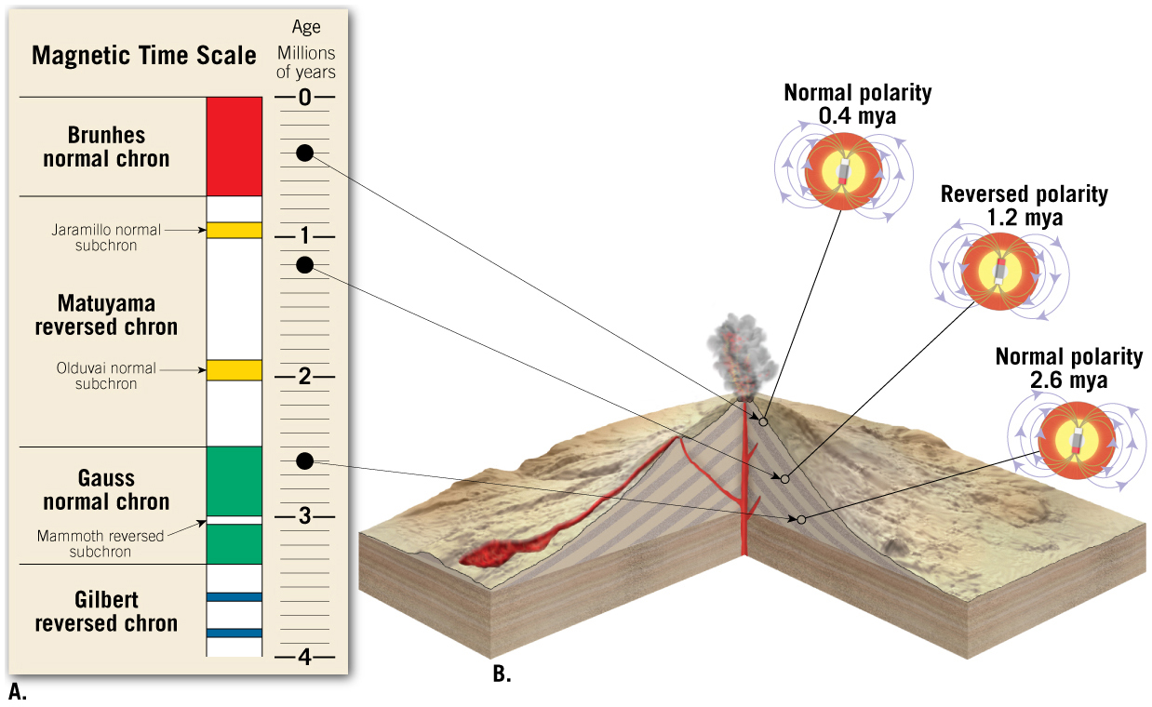
Paleomagnetic Reversals Recorded by Basalt Flows at Mid-Ocean Ridges
Tutorial

Slide 35
2.9 How Is Plate Motion Measured?
By using hot-spot “tracks,” like those of the Hawaiian Island–Emperor Seamount chain, and the age of the seafloor
Using space-age technology to directly measure the relative motion of plates
Very Long Baseline Interferometry (VLBI)
Global Positioning System (GPS)

Slide 36
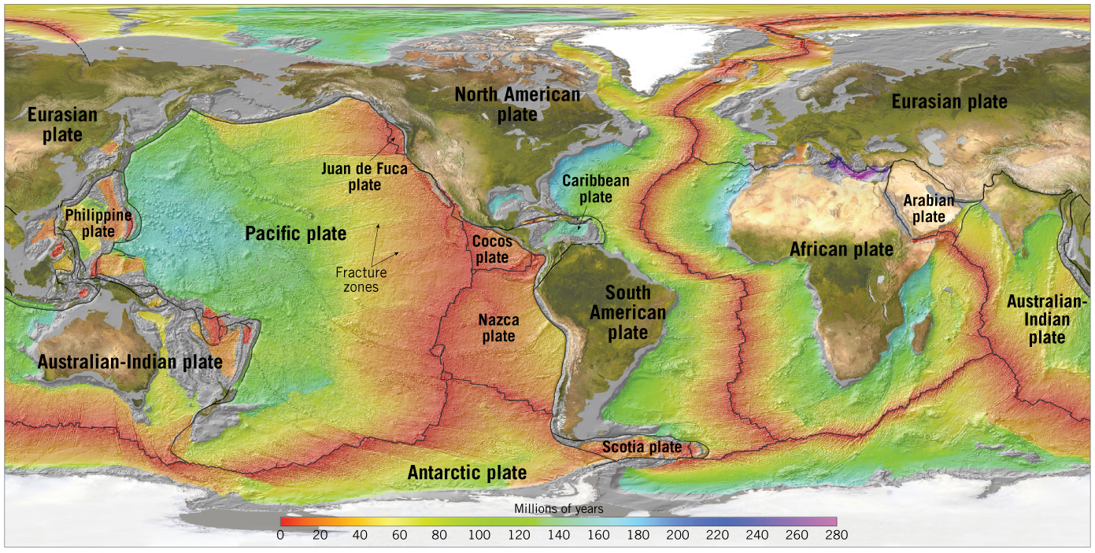
2.9 How Is Plate Motion Measured? (cont.)
Geologic Evidence for Plate Motion
By knowing the age of the seafloor and the distance from the spreading center, an average rate of plate motion can be calculated

Slide 37
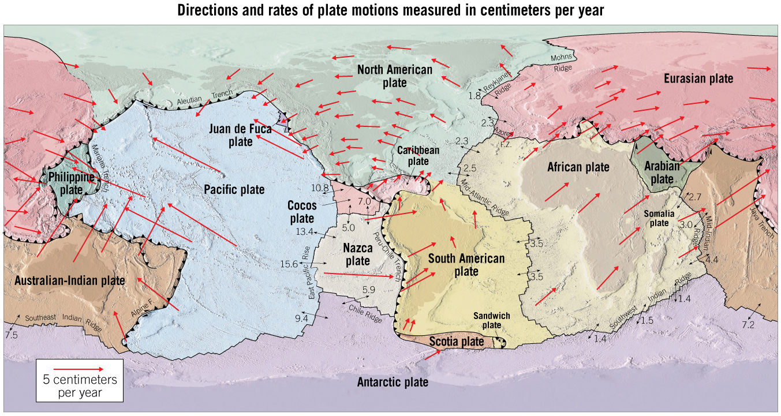
Directions and Rates of Plate Motions

Slide 38
2.10 What Drives Plate Motion?
Driving mechanism of plate tectonics
No one model explains all facets of plate tectonics.
Earth’s heat is the driving force through convection.
Several models have been proposed.
Slab-pull and ridge-push model
Descending oceanic crust pulls the plate.
Elevated ridge system pushes the plate.

Slide 39
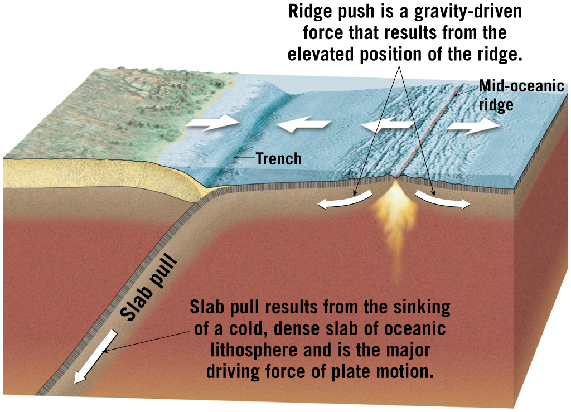
Mechanisms Contributing to Plate Motion

Slide 40
2.10 What Drives Plate Motion?
Several models have been proposed
Plate–mantle convection
Mantle plumes extend from mantle-core boundary and cause convection within the mantle
Models
Whole-mantle convection
“Layer Cake” Model

Slide 41
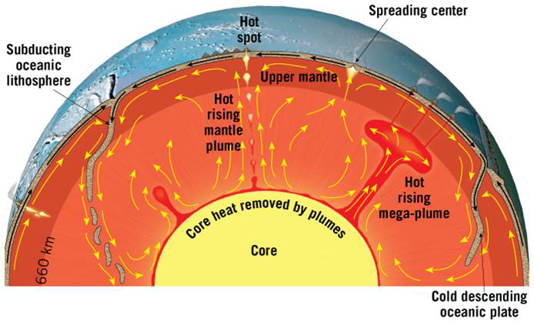
Whole-Mantle Convection

Slide 42
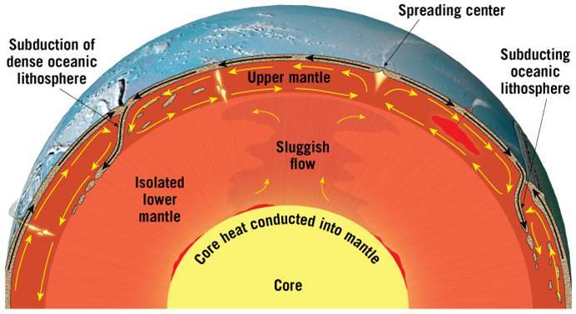
“Layer Cake Model”

